Slide 1
Seminar
On
Water Pollution
Notes:
1
1

Slide 2
Content
Introduction
What is water pollution?
Categories.
Groundwater pollution
Where does water pollution come from?
Causes of water pollution
Types of water pollution

Slide 3
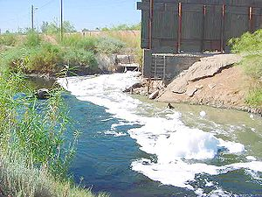
Introduction
Water pollution occurs when harmful substances are released into the water in large quantities which cause damage to people, wildlife, or habitat or indirectly into water bodies without proper treatment to remove harmful compounds.

Slide 4
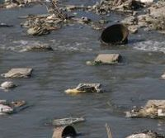
What is Water Pollution?
Water pollution is any chemical, physical or biological change in the quality of water that has a harmful effect on any living thing that drinks or uses or lives (in) it.
When humans drink polluted water it often has serious effects on their health. Water pollution can also make water unsuited for the desired use.

Slide 5
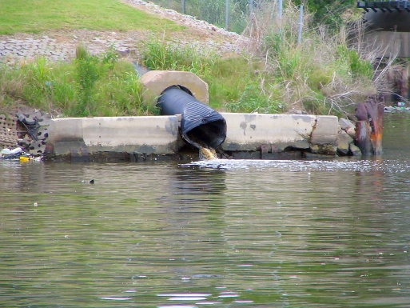
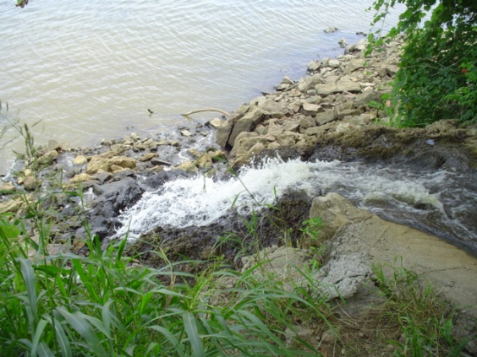
Categories
Point sources: Point source water pollution refers to contaminants that enter a waterway from a single, identifiable source, such as a pipe or ditch.
Nonpoint sources: Nonpoint source pollution refers to diffuse contamination that does not originate from a single discrete source.

Slide 6
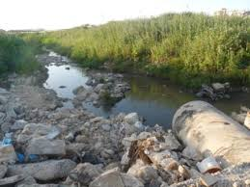
Groundwater pollution
Interactions between groundwater and surface water are complex. Consequently, groundwater pollution, sometimes referred to as groundwater contamination, is not as easily classified as surface water pollution.
By its very nature, groundwater aquifers are susceptible to contamination from sources that may not directly affect surface water bodies, and the distinction of point vs.non-point source may be irrelevant.

Slide 7
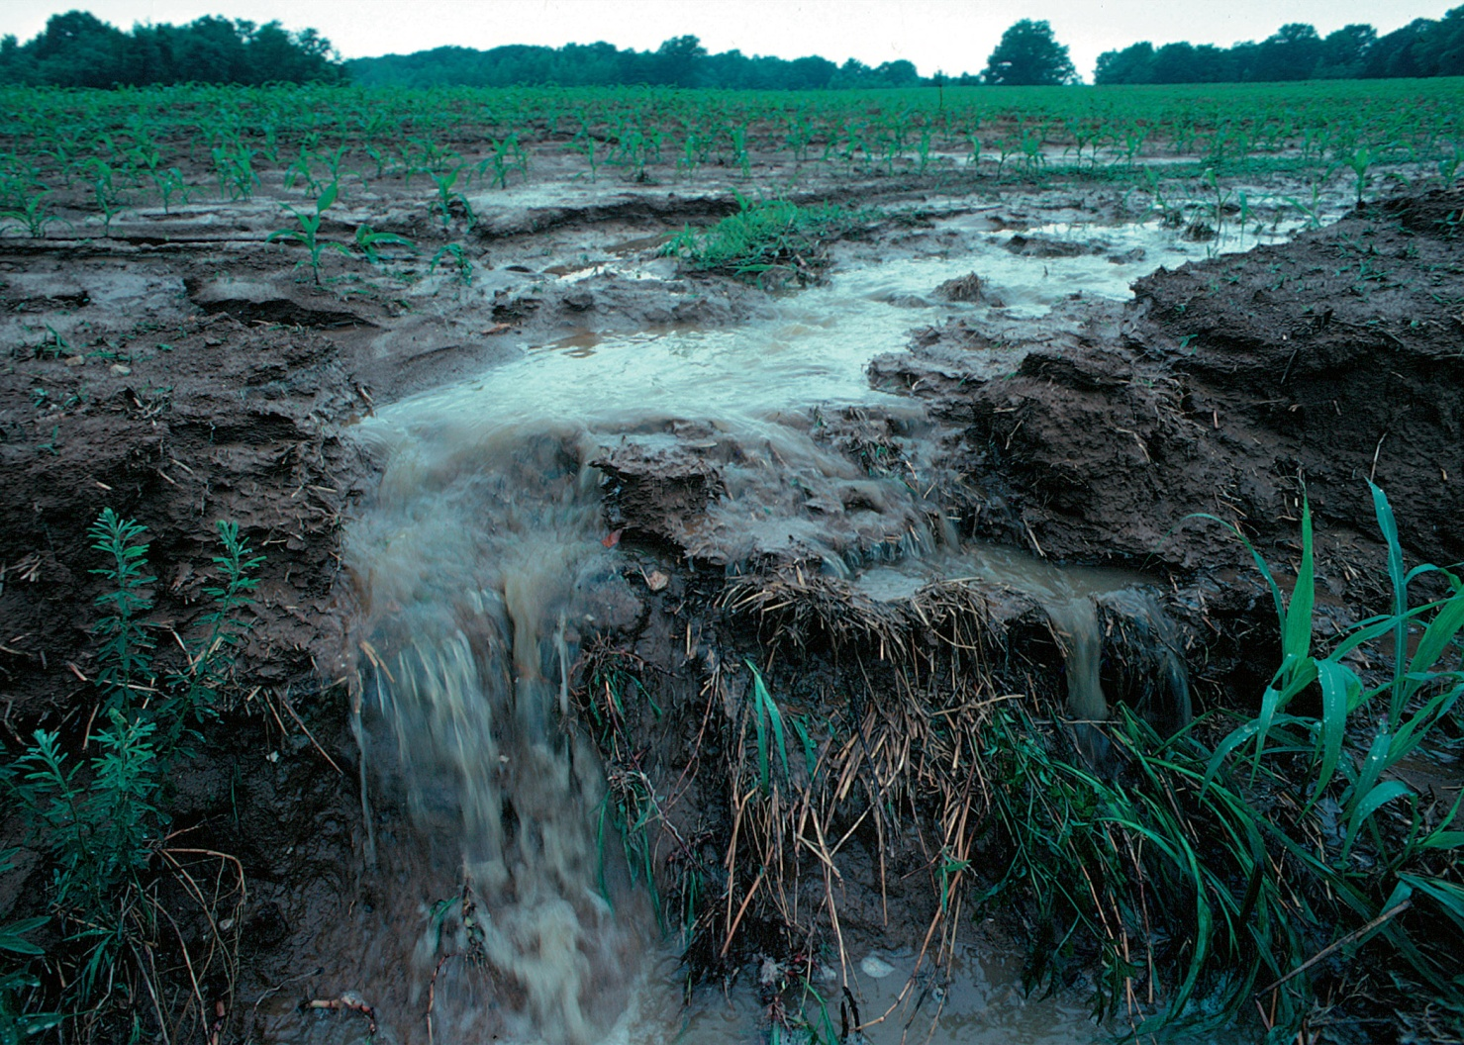
Where does water pollution come from?

Slide 8
Causes of water pollution
Ship pollution
Oil production
Agricultural runoff

Slide 9
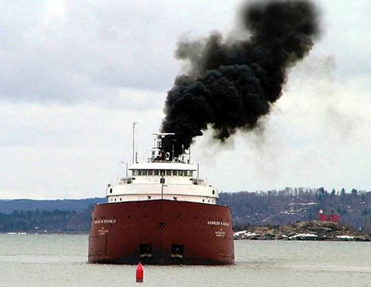
Ship pollution
Several decades after important international agreements to stop marine pollution were signed, oil leakage and waste disposal from ships (including cruise ships, warships, and tankers) remains a significant cause of ocean pollution.

Slide 10
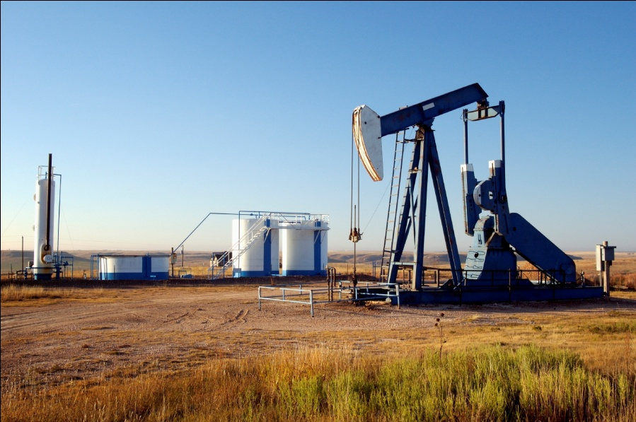
Oil production
Most oil is produced offshore and transported by ships, so it's no surprise that the oil industry is a big polluter. Despite the huge media attention they gain, tanker accidents account for only about 10 percent of the total amount of oil that enters the oceans. Unfortunately, they often create a huge amount of pollution in one place, overwhelming the local ecosystem.

Slide 11
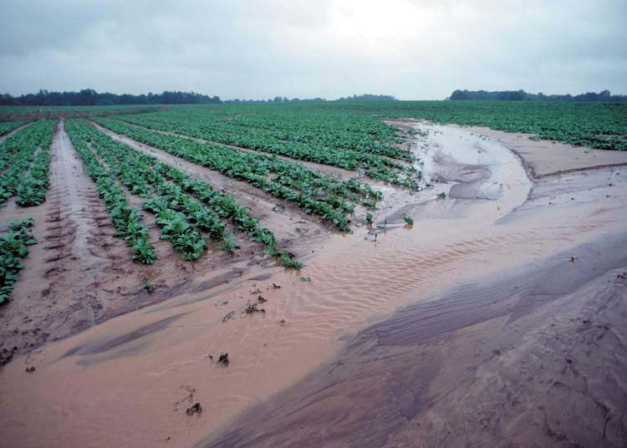
Agricultural runoff
Agricultural runoff: Fertilizers, weed killers, and other farm chemicals wash into rivers and groundwater, causing algal blooms and potentially contaminating drinking water.

Slide 12
Types of water pollution
Nutrients Pollution
Surface water pollution
Oxygen Depleting
Ground water pollution
Microbiological
Suspended Matter
Chemical Water Pollution
Oil Spillage

Slide 13
Thank u

